Slide 1
Analyzing and Predicting Ratings for Apps on Google Play Store
Made by: Nishtha

Slide 2
Importance of App Analysis
1
Why do we need it and who is interested?

Slide 3
Who needs it and why?
Developers: so that they can build apps most common among users
Marketing Companies: so that they can advertise in most popular apps
Common People: to explore apps related to their interests

Slide 4
Data Acquisition and Cleaning
2
From where do we get the data?

Slide 5
Kaggle
(10841, 13)
(64295, 5)
Data Source
Google Play Store Dataset
Google Play Store User Reviews Dataset

Slide 6
Data Cleaning Process
Dropped the translated description column in the user_reviews dataset.
1181 duplicate entries dropped and left with 9569 entries.
Loading Data
Duplicate Entries
Anomaly
Cleaning
Entry with rating 19 removed from the data frame.
Handled missing data, removed unnecessary columns and cleaned extra column data values.

Slide 7
Exploratory Data Analysis
3
What does the data tell us?

Slide 8
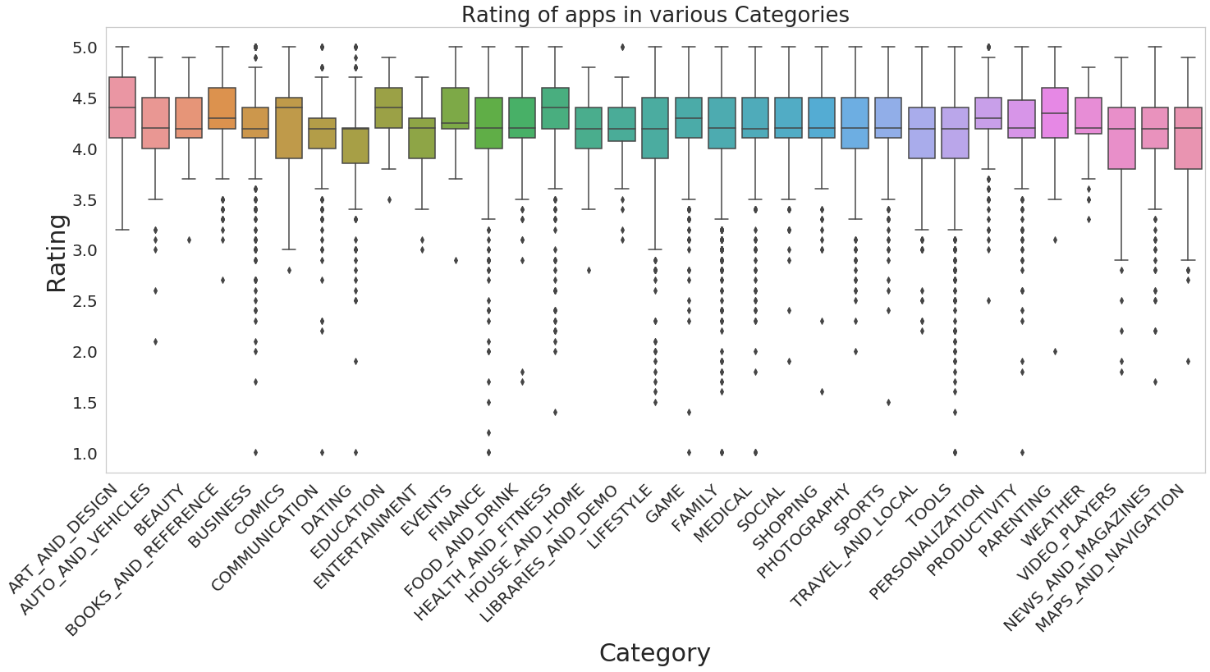
Influence of Categories on Ratings

Slide 9
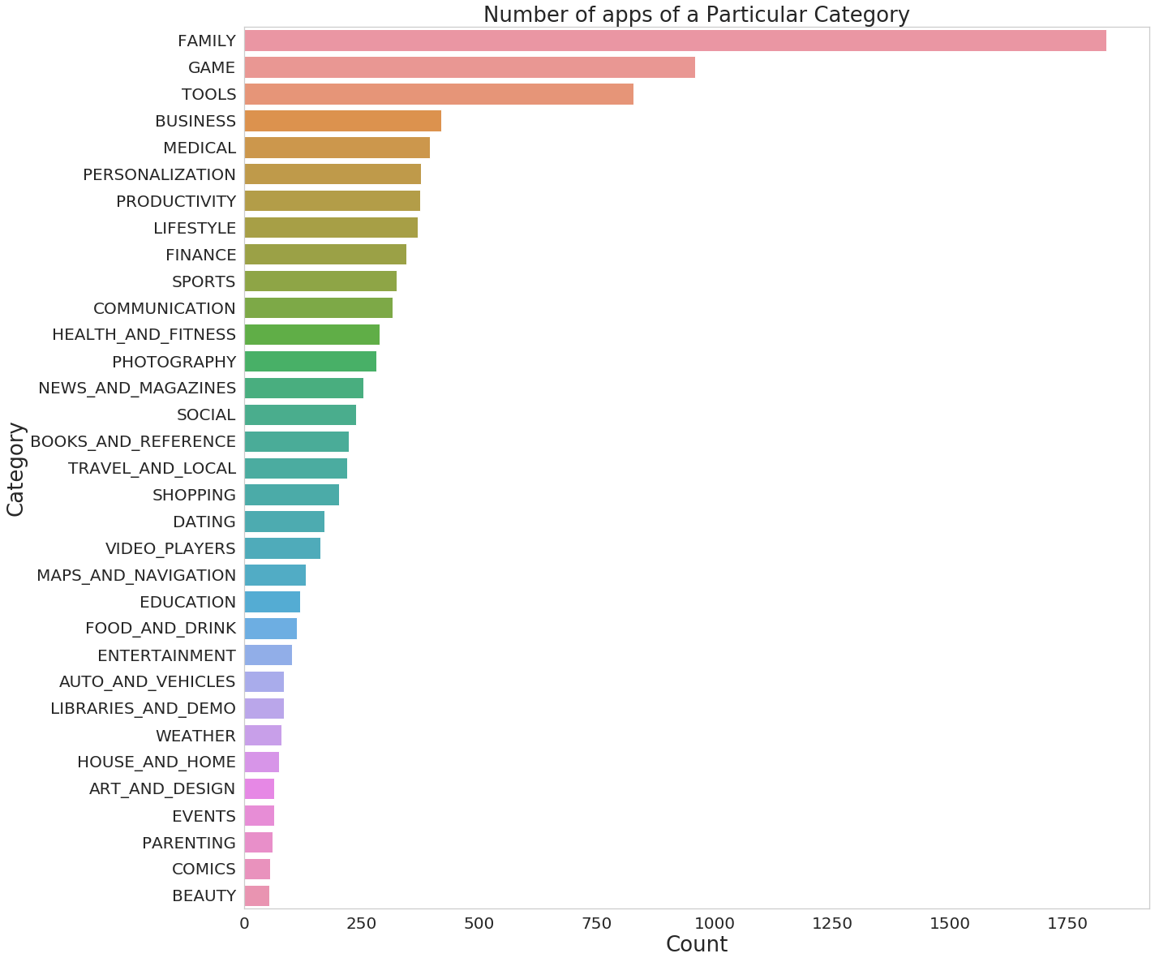
Most Important
Categories

Slide 10
Top 3 Categories
 | Category | Number of Apps
 | Family | 1,832
 | Games | 959
 | Tools | 827

Slide 11
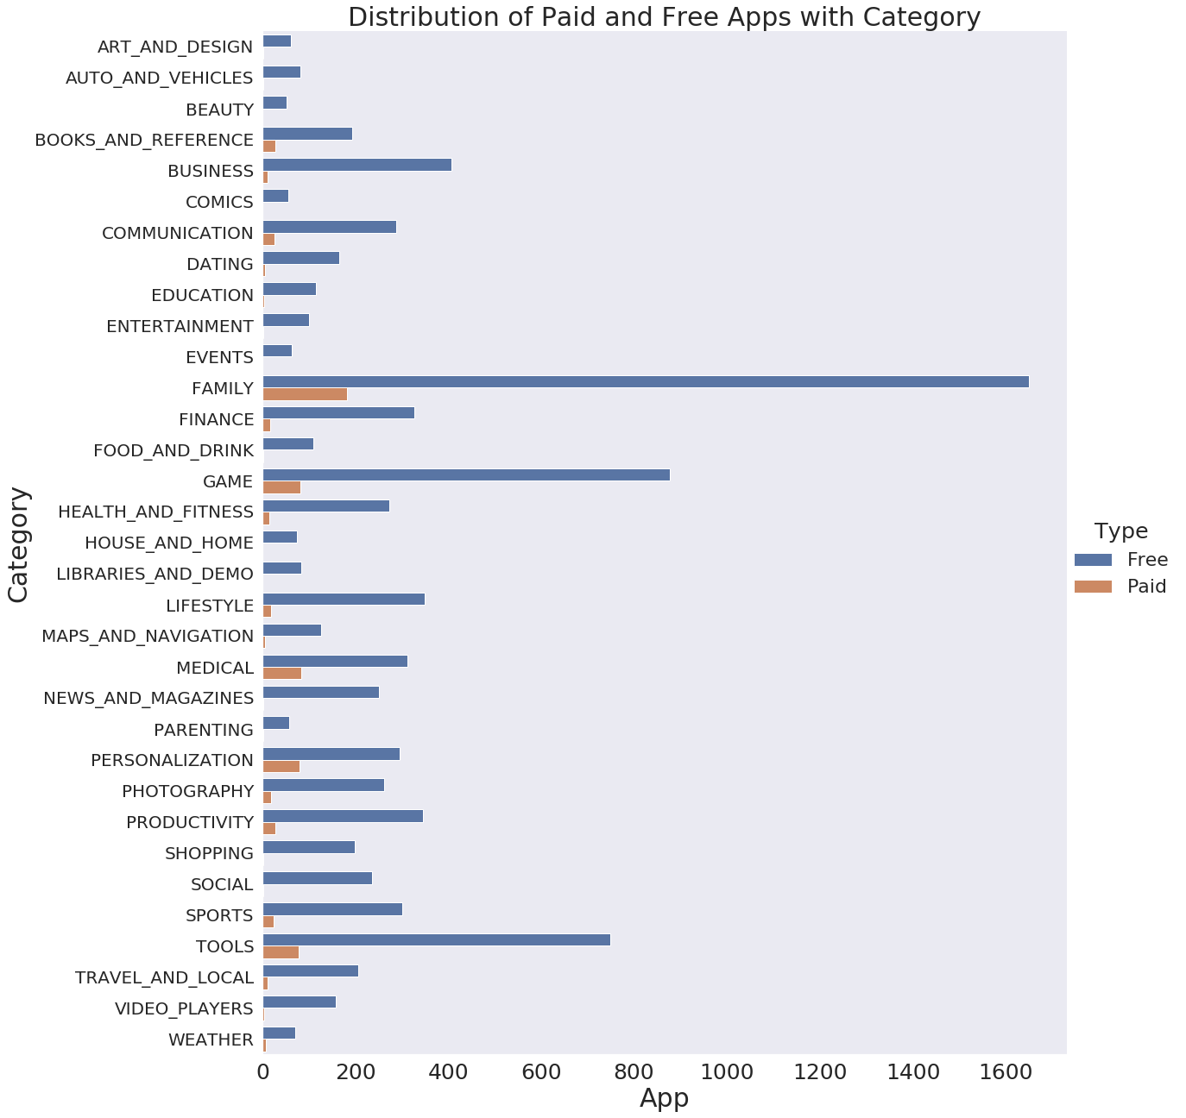
Effect of
Category and Type
Combined

Slide 12
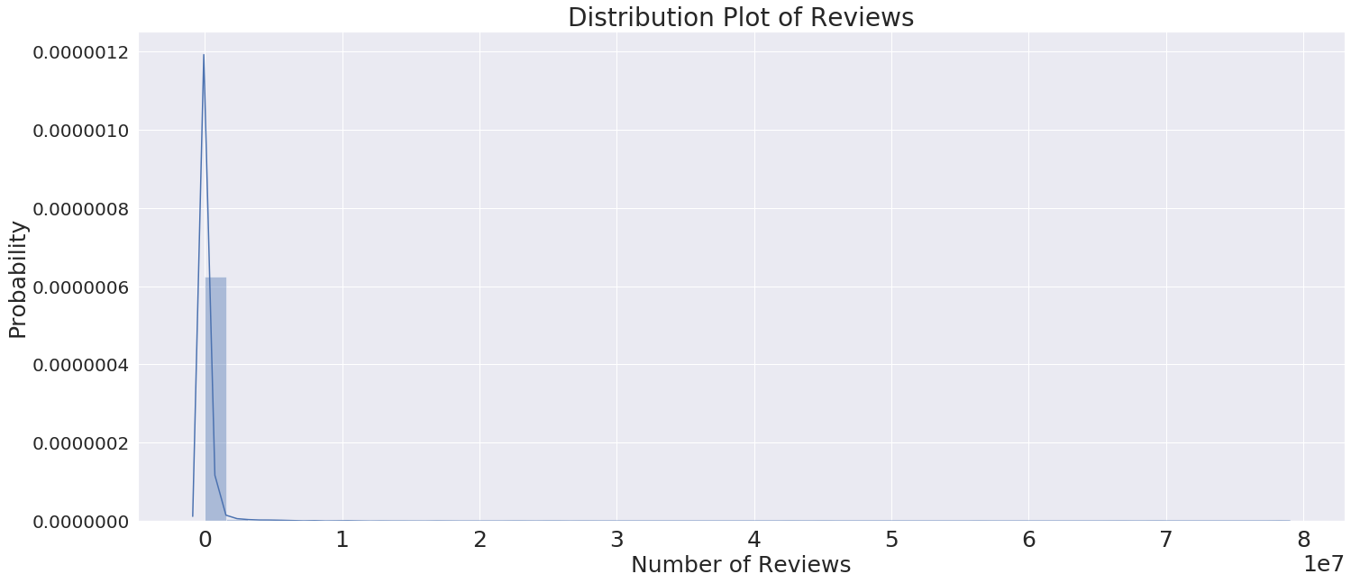
Most Reviewed Apps
Facebook
WhatsApp Messenger
Instagram

Slide 13
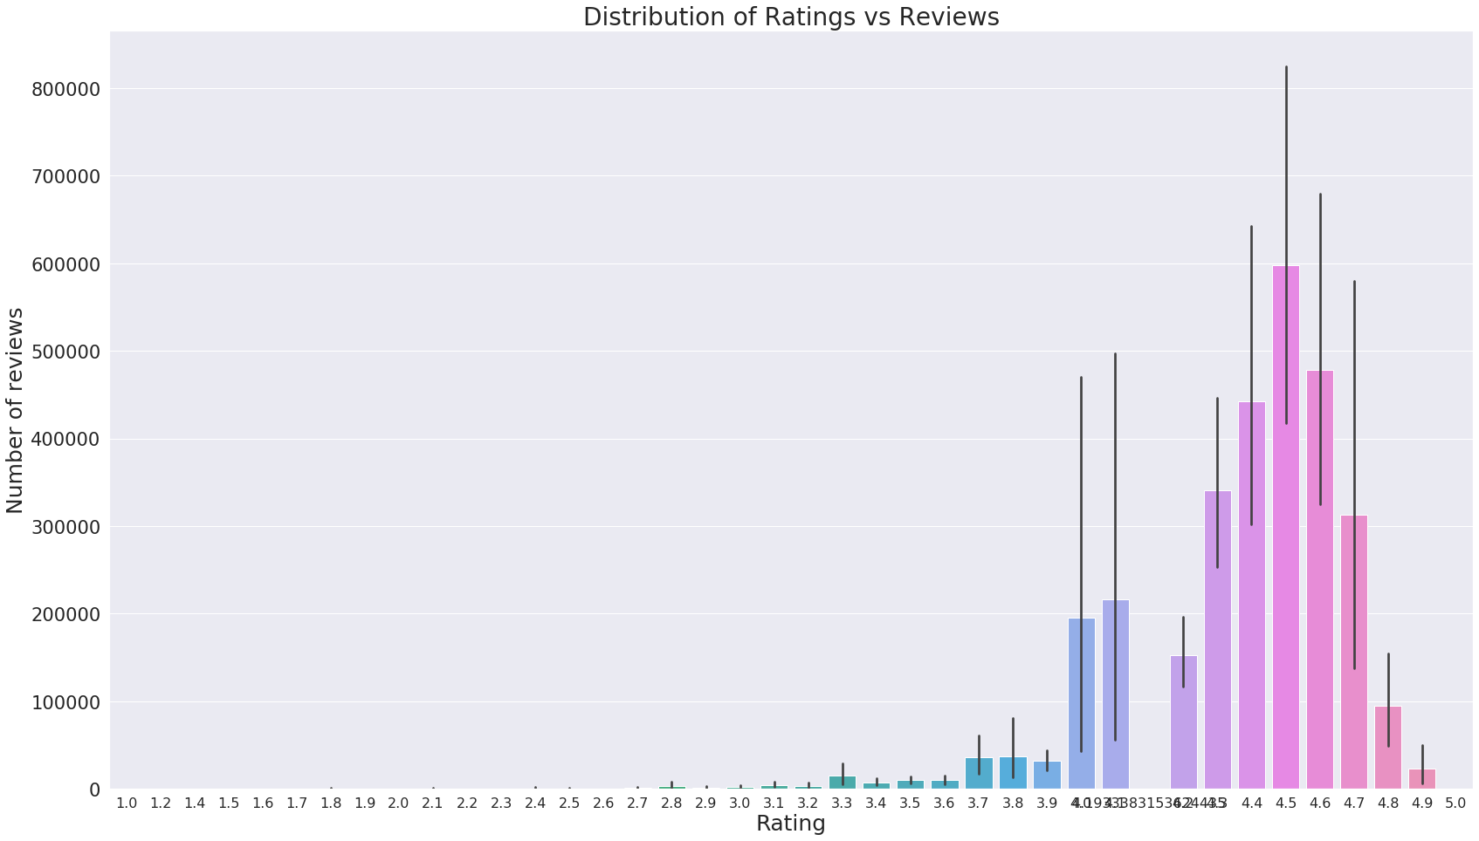
How Ratings and Reviews affect each other?

Slide 14
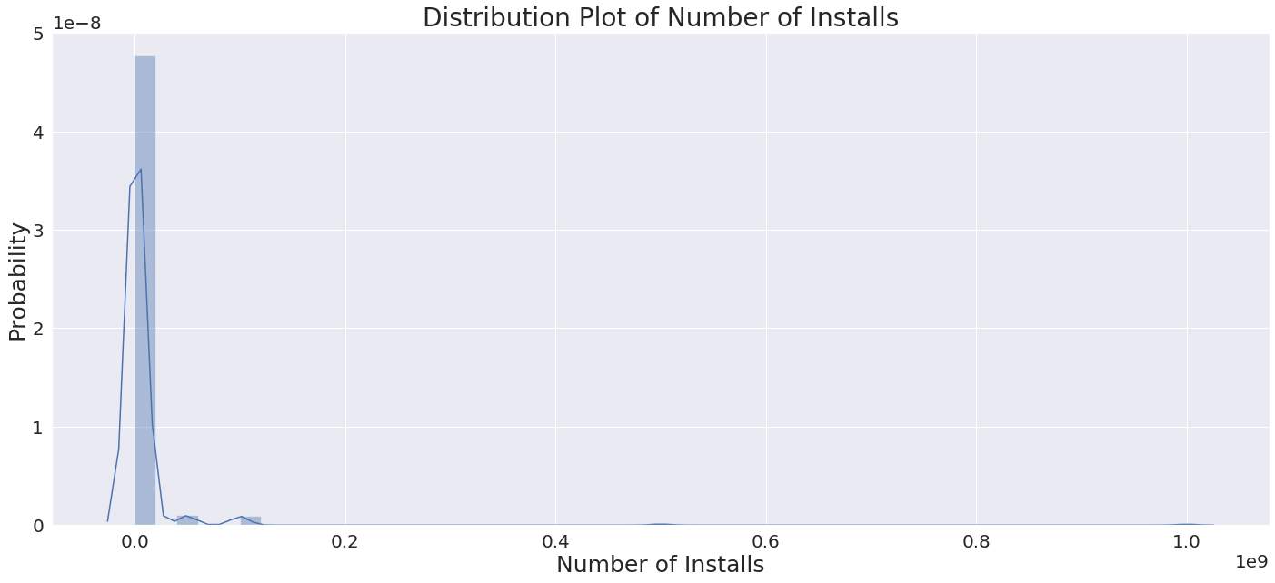
Most Installed Apps
Facebook
WhatsApp Messenger
Instagram
YouTube
Subway Surfers
Google Drive
Google Photos
Google Play Music
Google+
Google

Slide 15
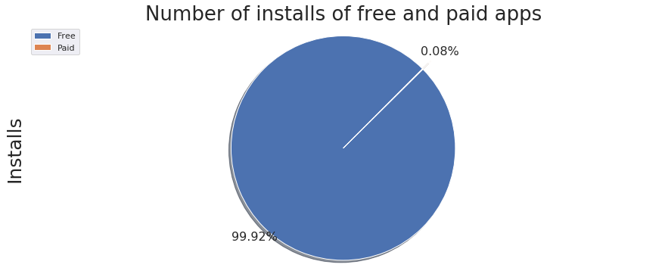
Installs and Types
TYPE | INSTALLS
Free | 75,065,572,646
Paid | 57,364,881

Slide 16
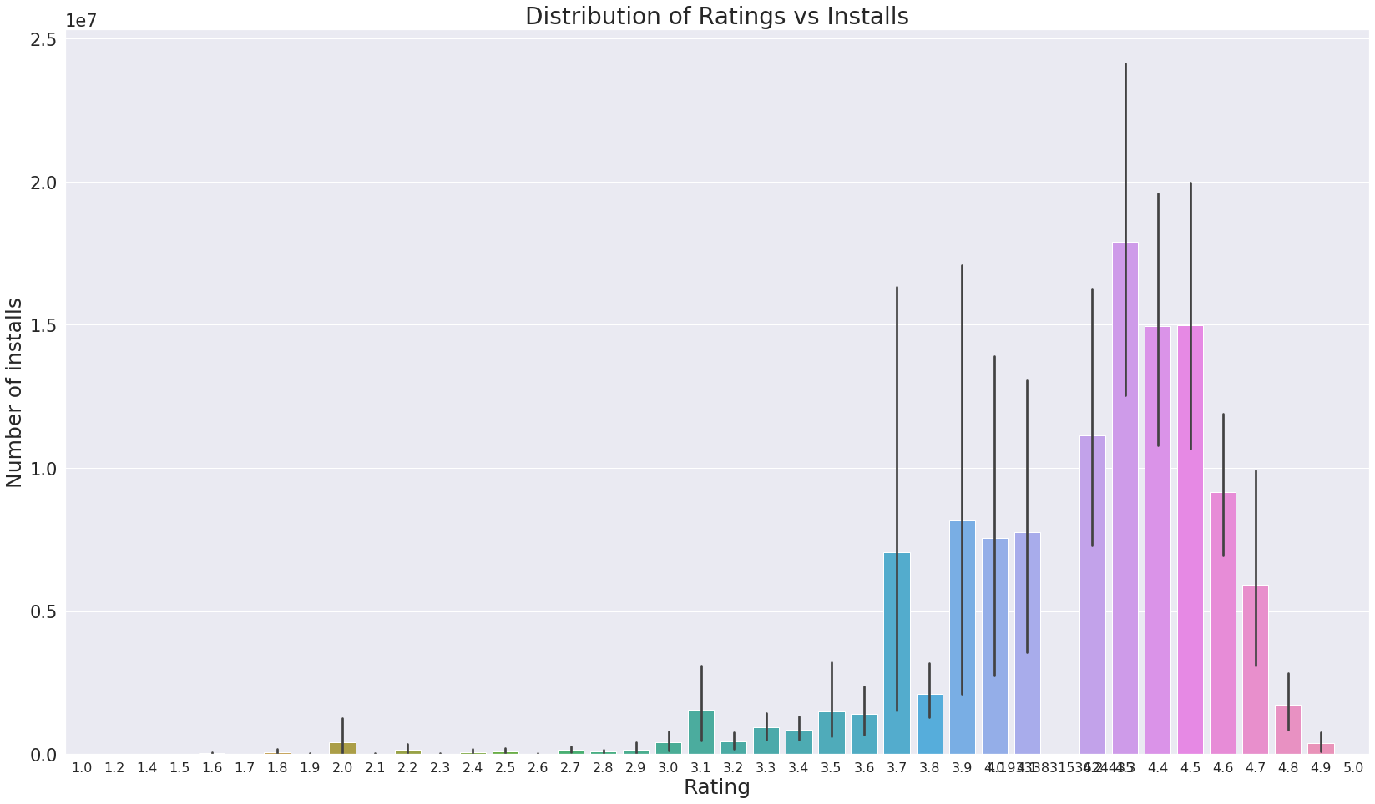
How Ratings and Installs affect each other?

Slide 17
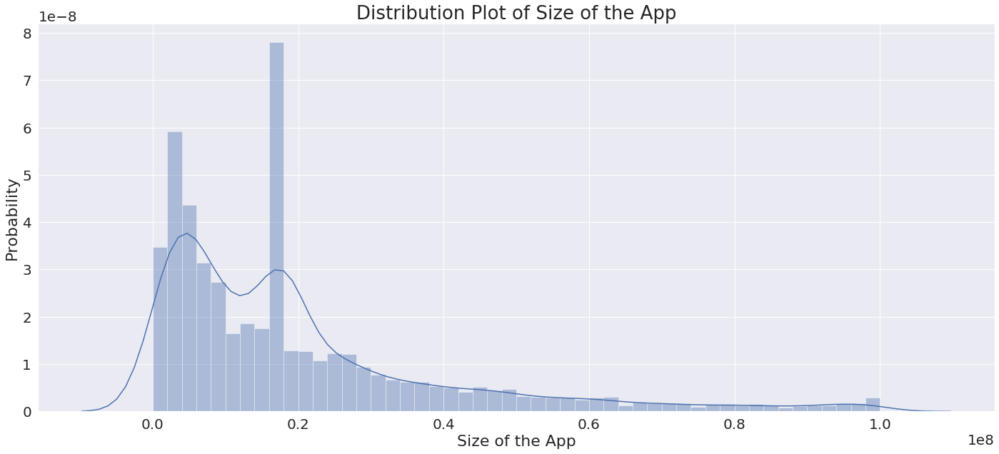
Distribution of Size of App across Data set

Slide 18
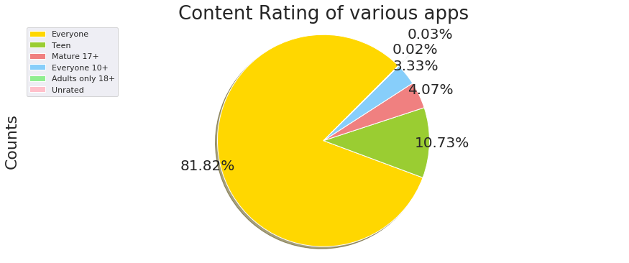
Content Ratings of Apps
7,903
Content Rating : Everyone

Slide 19
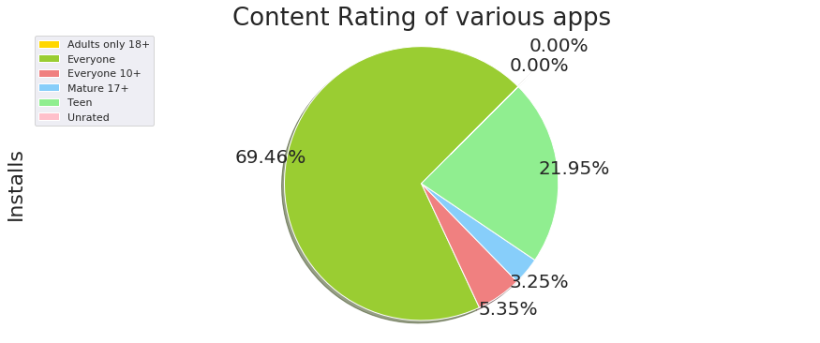
Installs of Apps of different Content Rating
52,179,352,961
Installs for Content Rating : Everyone

Slide 20
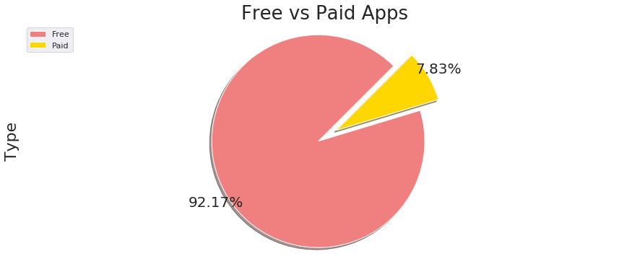
Free vs Paid Apps
TYPE | NUMBER OF APPS
Free | 8,903
Paid | 756

Slide 21
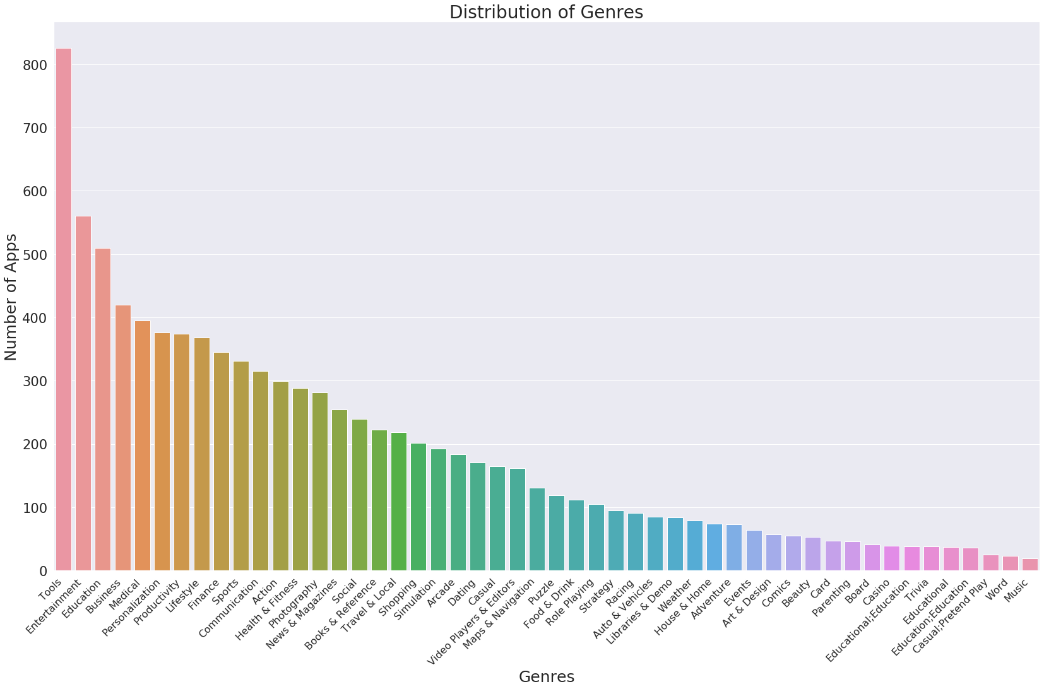
Exploring Genres

Slide 22
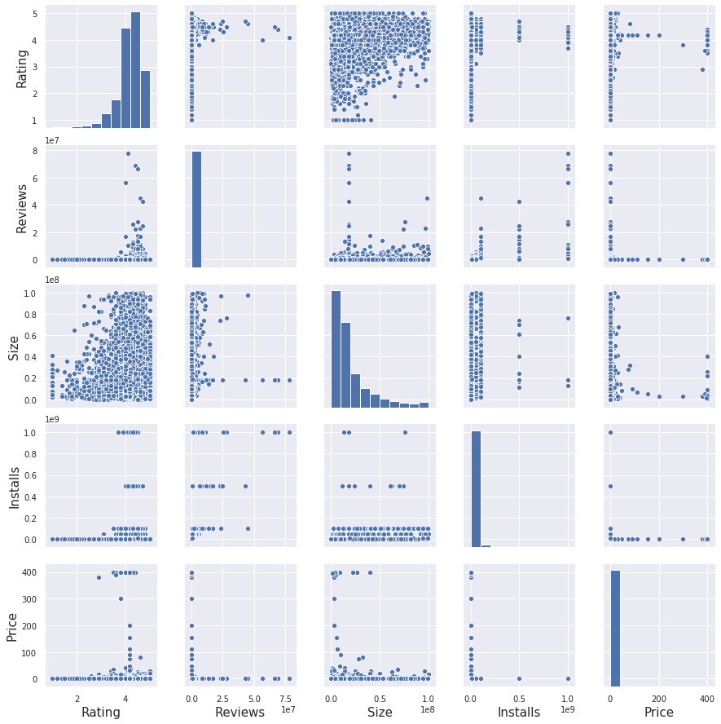
Pairwise
Plots

Slide 23
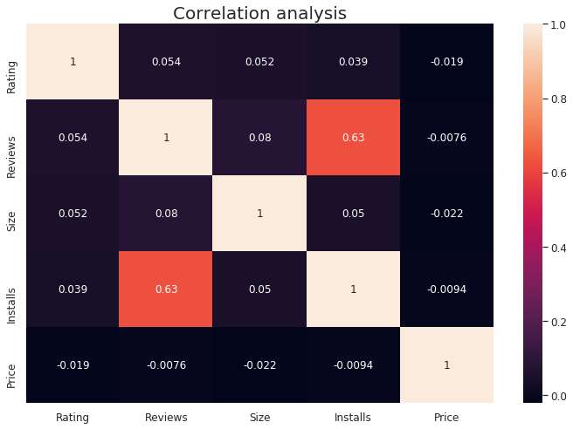
Correlation Map

Slide 24
Creating a model for Data
4
Let’s make our model intelligent

Slide 25
Data Modeling Process
Splitting the data set and separating dependent and independent variables.
Scaling of data and normalisation and then split to train/test sets.
Train / Target
Scale and Split
Label Encode
Modeling
Label encoding the Type, Genre, Content Rating and Category columns.
Employing Ridge Regression, Elastic Net Regression and Random Forest Regression.

Slide 26
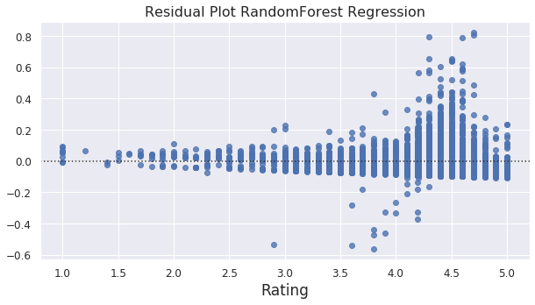
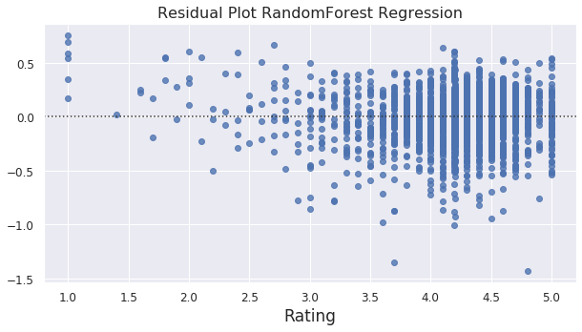
Train Set
Random Forest
Regression
(Residual Plots)
Test Set

Slide 27
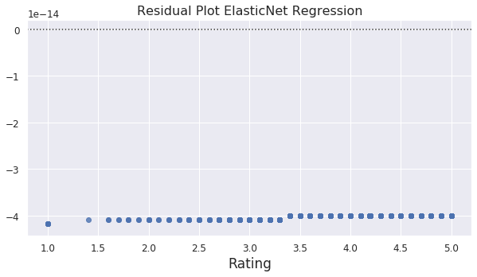
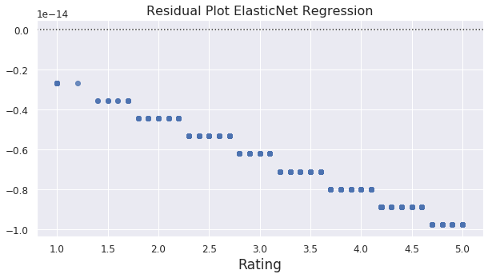
Train Set
Elastic Net
Regression
(Residual Plots)
Test Set

Slide 28
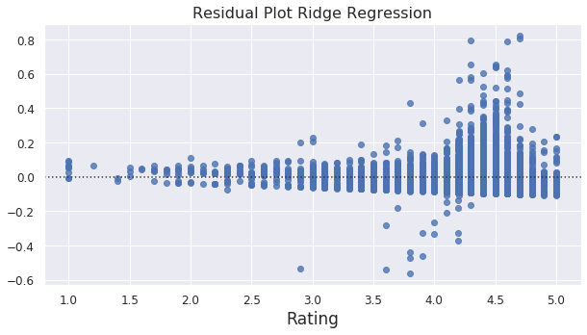
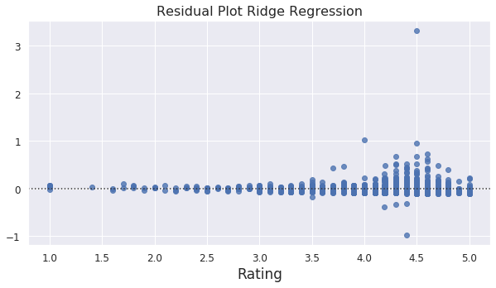
Train Set
Ridge Regression
(Residual Plots)
Test Set

Slide 29
Results for various Models
*MSE : Mean Squared Error
MODEL | MSE* (TRAIN SET) | MSE* (TEST SET)
Random Forest | 0.03139 | 0.22994
Ridge | 0.24119 | 0.25395
Elastic Net | 0.23563 | 0.25423

Slide 30
Concluding Remarks
5
What did we learn ?

Slide 31
Major Findings
Developers: should build quality apps in most common categories and may also try to target less common categories only if they have good content.
Marketing Companies: advertise in top 40 most installed apps for best results.
Category and Genre: affect the app market the most
Paid vs Free: free apps are most preferred
Size: small sized apps are preferred by customers
Content Rating: ‘Everyone’ has the largest viewership

Slide 32
Thank You

